Slide 1
Trade financing on RSK blockchain to boost international & domestic trades

Slide 2
Problem
Generation of Letter of Credit takes much time and needs good traction with banks
Several Banks are involved in execution of a LC e.g. issuing bank, advisory bank, intermediate banks (include confirming bank, reimbursing bank & negotiating bank).
Costs of LC are significantly high. Additionally, currency exchange fees increase the expenses.
Conventional LCs aren’t feasible for smaller trades
Conventional LC execution is cumbersome
Centralized operations of banks can adversely affect the trade financing ecosystem.

Slide 3
Solution
LC as a smart contract on RSK blockchain.
A platform which generates LC smart contract and guards its execution on blockchain: CreditGuard
A consensus human oracles to evaluate any documents/proofs against the smart contract (or LC) terms: shuttlecock
Pegging can be done by user, else can be done by CreditGuard

Slide 4
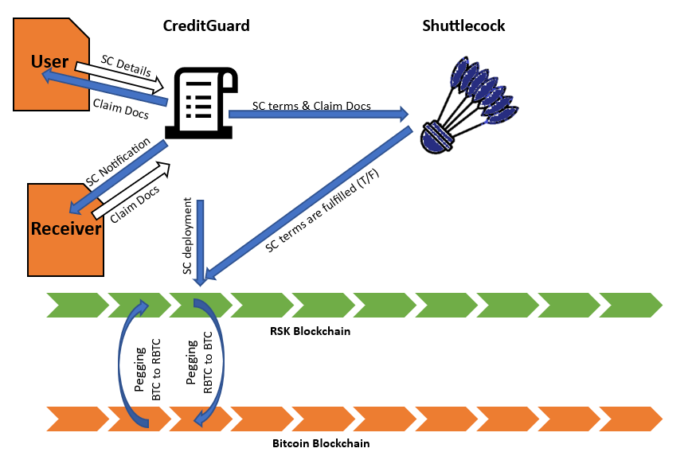
Architecture & Process Flow

Slide 5
Advantages
The LC on RSK blockchain will be cheaper
It can be generated within few minutes
Auto execution and much faster settlement
Bitcoin is widely accepted liquid asset. Hence any trade partner would agree to accept the payment in terms of BTC or RBTC.
Decentralized LC is better than conventional LCs. No loss of credit is ensured.

Slide 6
Potential Customers
International Traders
Domestic Traders
Commission agents
Consumers expecting ensured quality before payment.
E-commerce sites can integrate this feature.
Can be integrated with insurance companies

Slide 7
Market
Global letter of credit confirmation market size was valued at USD 4.30 Billion in 2019 and is projected to reach USD 4.99 Billion by 2027, growing at a CAGR of 3.18% from 2020 to 2027.
Above market consists of LC confirmation (incurred by confirming & issuing banks only). Additionally there advising, reimbursing & negotiating sections.
The global trade finance market size reached US$ 48.2 Billion in 2022. And the market is expected to reach US$ 70.0 Billion by 2028, exhibiting a growth rate (CAGR) of 6.2% during 2023-2028. This market also includes that of letter of credit.

Slide 8
Competition Perspective
All the incumbent competitors in this market are banks or traditional financial institutions. Our solution is going to be only of its kind service based on blockchain offering faster, more secure and easy execution of LCs. Thus we expect to grab a significant portion of above market.

Slide 9
Technical Status
MVP is available.
CreditGuard at: https://creditguard.kalpasrusti.com
Shuttlecock at: https://shuttlecock.kalpasrusti.com
Standard solidity code of LC smart contract (sample) at: https://github.com/GauravBiraris/LC-Sample/commit/c631d43407a501c027738570a48cb71554955c67
Demonstration video at: https://www.youtube.com/watch?v=S2DaIBGiGXc

Slide 10
Future Plans
MVP exposure and market outreach
Commercialization

Slide 11
Thank You!

